Slide 1
Ray Tracing – Additional Topics
CS460: COMPUTER GRAPHICS

Slide 2
Ray Intersections

Slide 3
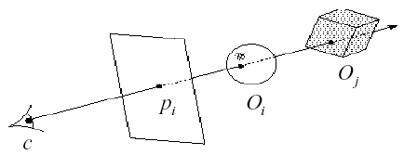
Mathematics
The heart of any ray tracer, or ray casting for hidden surface removal, is the intersection routines.
Each kind of primitive has different properties, so we have different intersection equations.
(d_{x},d_{y},d_{z})^{T}
(x₀, y₀, z₀)^{T}

Slide 4
Parametric Ray Equation
Let
  the COP be P₀ = ( x₀ , y₀ , z₀ ) ^{T} and
  the viewing direction be D = ( d_{x} , d_{y} , d_{z} ) ^{T}
Any point P lying on the eye ray is given by:
        P = P₀ + D t
Or writing each coordinate separately:
x = x₀ + d_{x} t
y = y₀ + d_{y} t
z = z₀ + d_{z} t

Slide 5
Ray Parameterization
The parametric ray equation is given by:
        P = P₀ + D t
Points along the line of sight is parametrized by t:
t = 0 , at COP (eye/viewpoint)
t < 0 , behind COP
t > 0 , in front of COP
Non-negative t
(d_{x},d_{y},d_{z})^{T}
(x₀, y₀, z₀)^{T}

Slide 6
Mathematics
Consider an implicit surface (i.e., spheres and other quadrics defined by an implicit equation)
F ( x , y , z ) = 0
In the following, all surface equations are assumed to be in the object space coordinate system. Therefore, we need to transform the ray before testing for intersection.

Slide 7
Intersecting Spheres
The (implicit) equation of a unit sphere is given by:
x² + y² + z² = 1
Assuming a unit sphere (radius is equal to one). Substituting the parametric ray equation yields the following:
(d_{x} ² + d_{y} ² + d_{z} ² ) t² + 2(d_{x} x₀ + d_{y} y₀ + d_{z} z₀) t
+ (x₀² + y₀² + z₀²) – 1 = 0
which is a quadratic equation in t.

Slide 8
Intersecting Spheres
Solving the quadratic equation in t gives the solution.
Ray misses the sphere if the discriminant is negative.
If the discriminant is non-negative, the smallest positive t is taken. (think about why)
Then, the intersection point is given by:
        x = x₀ + d_{x} t₁
        y = y₀ + d_{y} t₁
        z = z₀ + d_{z} t₁

Slide 9
Possible cases
1
1. Ray intersects sphere twice
with t>0
2. Ray tangent to sphere
3. Ray intersects sphere with t<0
4. Ray originates inside sphere
5. Ray does not intersect sphere
2
3
4
5

Slide 10
Intersecting Quadrilaterals
Solving a ray-plane equation determines if the ray hits the polygon plane (which is an infinite plane). It is followed by an extent check to see if the ray hits the polygon.
Again, let’s write the ray equation as:
P = P₀ + D t
which defines a ray as:
P₀ = ( x₀ , y₀ , z₀ ) ^{T}
D = ( d_{x} , d_{y} , d_{z} ) ^{T}

Slide 11
Intersecting Quadrilaterals
Define the plane in terms of [A B C D ] as:
  A x + B y + C z + D = 0
Note: the unit vector normal of the plane is defined by:
P_{normal} = P_{n} = [A B C ] ^{T}

Slide 12
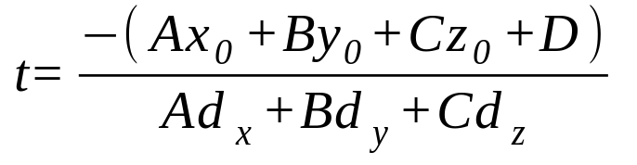
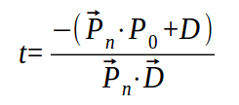
Intersecting Quadrilaterals
Substituting the ray equation into the plane equation yields:
A (x₀ + d_{x} t) + B (y₀ + d_{y} t) + C (z₀ + d_{z} t) + D = 0
Solving for t
In vector form, the equation becomes
The vector equation will have no solution if the dot product of P_{n} and
D is zero (ray direction exactly perpendicular to plane normal).

Slide 13
Intersecting Quadrilaterals
Define
  v_{d} = P_{n} • D
  v₀ = - (P_{n} • P₀ + D)
  Hence,
t = v₀ / v_{d}
If t < 0, then the line defined by the ray intersects the plane behind the COP. Therefore, no intersection actually occurs.
Else, the intersection point is given by:
P = P₀ + D (v₀ / v_{d})

Slide 14
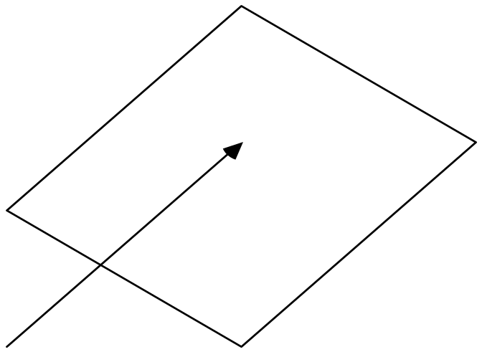
Possible Cases
P_{n} • D = 0
P_{n} • D > 0
t > 0
t < 0
P_{o}
P_{o}

Slide 15
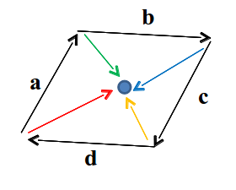
Intersecting Quadrilaterals
Further extent check is required to see if the intersection point lies within the region bounded by the quadrilaterals (coz the plane is not an “infinite plane” practically)
If cross product of 4 directed edges with vector to intersection point have same sign, it lies inside
Same method works for other convex polygons
4 cross products:
red with a
green with b
blue with c
orange with d

Slide 16
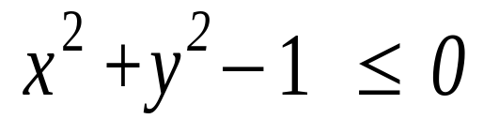
Intersecting a disk
Intersecting circles is similar to intersecting quadrilaterals
The extent check, after computing the intersection point, becomes one of using the circle equation
Consider a unit circle lying on the z=0 plane. If the ray intersects the z=0 plane, it also intersects the circle if:

Slide 17
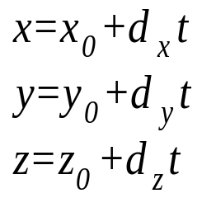

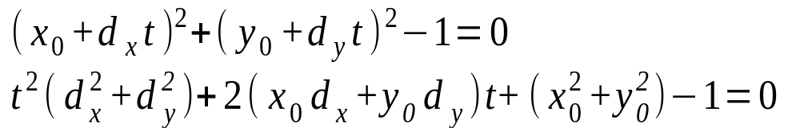
Intersecting Cylinders
Recall the parametric ray equation is:
The equation for an infinite cylinder (along Z-axis) is:
Substituting the ray equation yields a quadratic equation in t:
An extent check is applied for a finite cylinder.

Slide 18
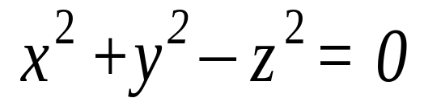
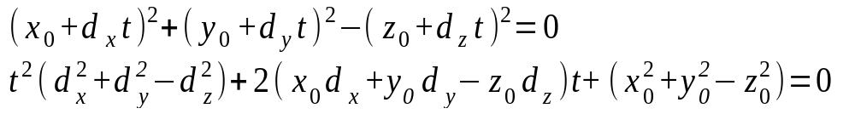
Intersecting Cones
The implicit equation for a cone is
Substituting the ray equation into the above yields a quadratic equation in t :
Compute the discriminant, and solve for t if the discriminant is non-negative.

Slide 19
Ray Tracing Details
Notes:
Break: http://area.autodesk.com/fakeorfoto/challenge

Slide 20
Goodies
There are some advanced ray tracing features:
  1. Acceleration techniques
  2. Antialiasing
  3. CSG
  4. Distributed ray tracing
There are some features that dramatically increase the power of a ray tracer:
  Texture and Environment Mapping
  Particle systems
  Caustics and participating media
  …

Slide 21
1. Acceleration Techniques
Problem: ray-object intersection is very expensive, especially we have to test ray-object intersection for every object against every ray
So, we should make intersection tests faster and try to do fewer tests

Slide 22
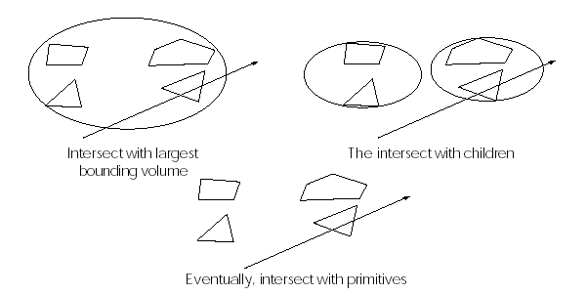
Hierarchical Bounding Volumes
Arrange the scene as a tree
  Internal nodes contain primitives with very simple intersection tests (e.g., spheres). Each node’s volume contains all objects in sub-tree
  Leaf nodes contain original geometry
Like Binary Space Partitioning (BSP) trees, the potential benefits are big but the hierarchy is hard to build (Note: BSP can be used to speed up ray tracing as well)
Notes:
http://www.youtube.com/watch?v=tT81VPk_ukU

Slide 23
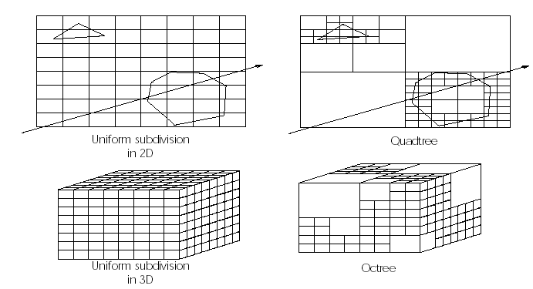
Spatial Subdivision
Divide up space and record what objects are in each cell
Trace ray through voxel array

Slide 24
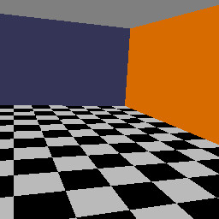
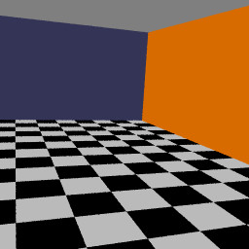
Any Difference?
Notes:
http://www.youtube.com/watch?v=KZAEW88ufLc
http://www.youtube.com/watch?v=YdzRhGgJA4c
And AMSS

Slide 25


2. Antialiasing
So far, we traced only one ray through each pixel in the final image. Is this an adequate sampling for the pixel color?
This quantization resulted from inadequate sampling is a form of aliasing. Aliasing is visible as “jaggies” in the ray-traced image.
We really need to color the pixel based on the average color of the square it defines.

Slide 26
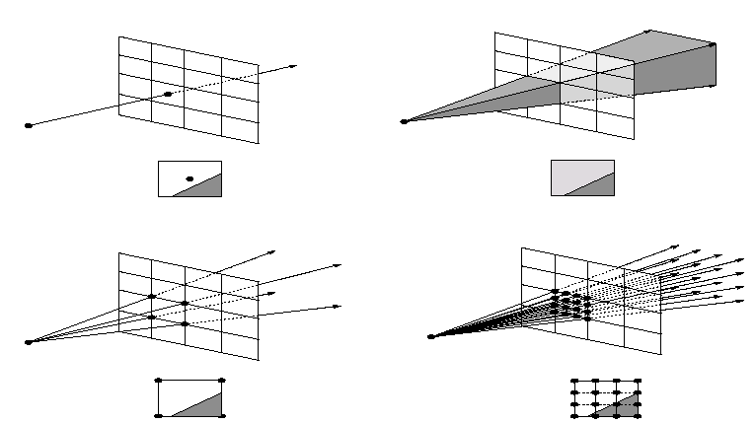
Supersampling
We can approximate the average color of a pixel’s area by firing multiple rays and averaging the result.
1 ray
= 1 sample
boundary of
two objects
2x2 rays
= 4 samples
4x4 rays
= 16 samples

Slide 27
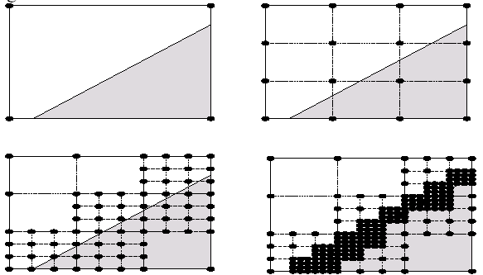
Adaptive Sampling
Uniform supersampling can be wasteful if large parts of the pixel don’t change much.
So we can subdivide regions of the pixel’s area only when the image changes in that area:
How do we decide when to subdivide?

Slide 28
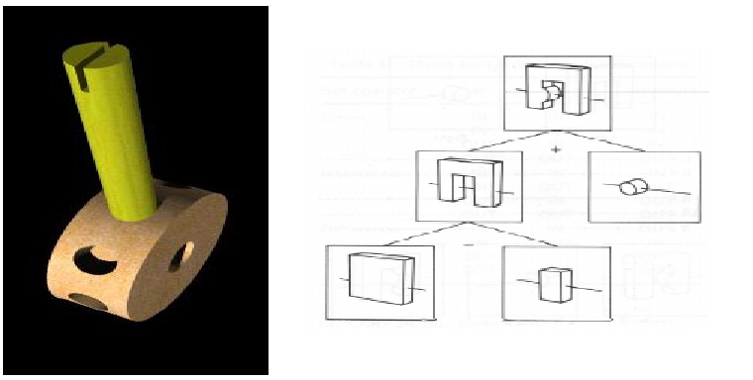
3. CSG
CSG (constructive solid geometry) is an incredibly powerful way to create complex scenes from simple primitives.
CSG is a modeling technique; basically, we only need to modify ray-object intersection.
Notes:
http://www.youtube.com/watch?v=PHYF51Asav8
http://www.youtube.com/watch?v=GwT7Vk0KEzs

Slide 29
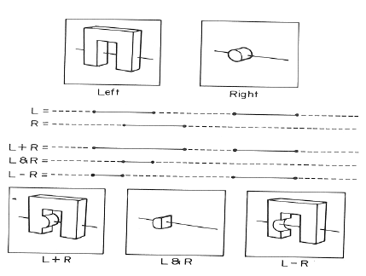
CSG Implementation
CSG intersections can be analyzed using “Roth diagrams”.
  Maintain description of all intersections of ray with primitive
  Functions to combine
  Roth diagrams under
  CSG operation
An elegant and extremely slow system

Slide 30
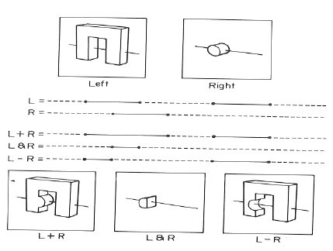
Consider raycasting one scanline on the left and right primitive respectively:

Slide 31
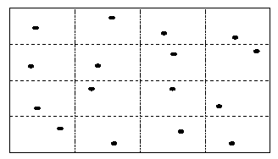
4. Distributed Ray Tracing
Usually known as “distributed ray tracing”, but it has nothing to do with distributed computing
General idea: instead of firing one ray, fire multiple rays in a jittered grid
Distributing over different dimensions gives different effects
Example: what if we distribute rays over pixel area?

Slide 32
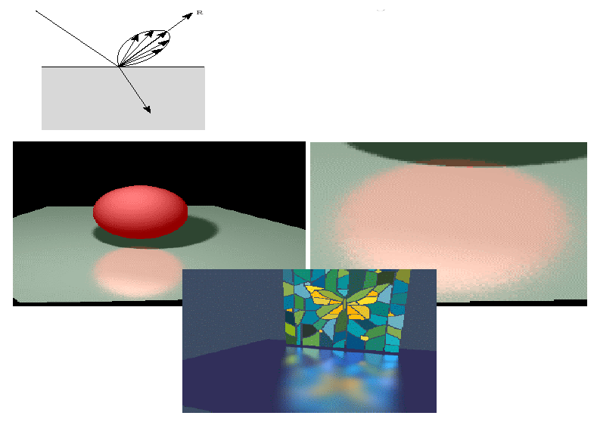
Distributed Reflections
Distributing rays over reflection gives more reflected rays per intersection pt

Slide 33
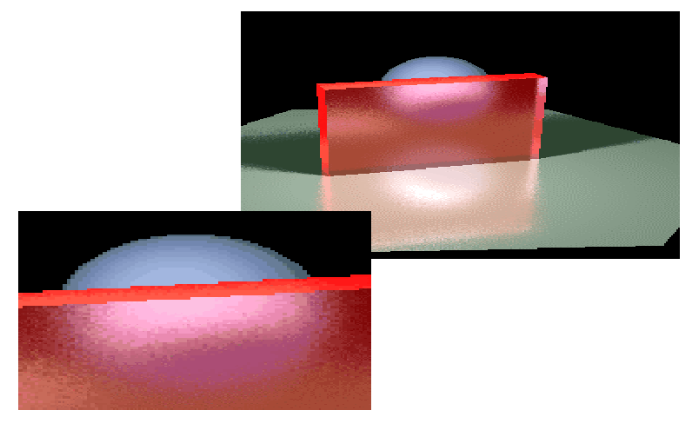
Distributed Refractions
Distributing rays over transmission direction gives
more refracted rays
per intersection pt

Slide 34
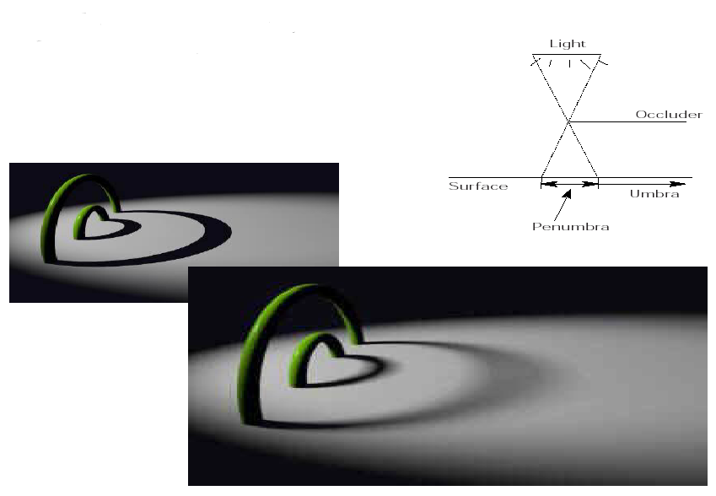
Distributing Over Light Area
Distributing rays over light area gives:
One shadow ray:
More shadow rays
per intersection pt:
Very Good illustration here:
http://www.flipcode.com/archives/Raytracing_Topics_Techniques-Part_5_Soft_Shadows.shtml

Slide 35
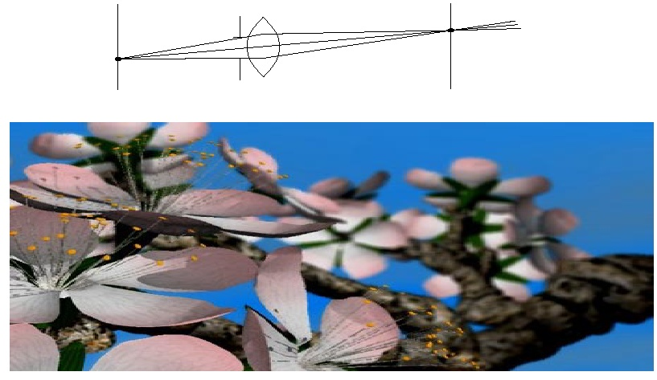
Distributing Over Aperture
We can fake distribution through a lens by choosing a finite aperture and shooting multiple rays (conceptually, real implementation is more involved)
more primary rays
(deflected by a lens)

Slide 36
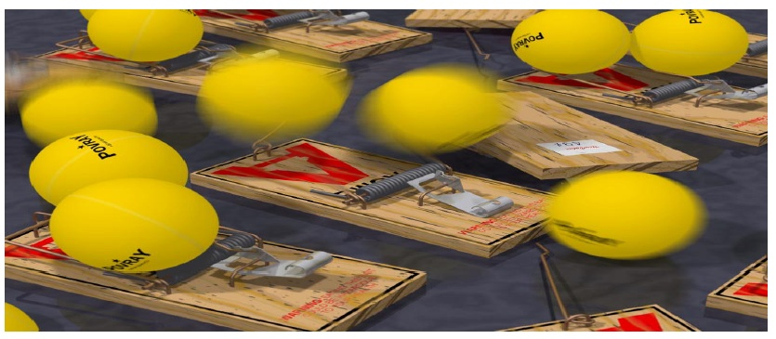
Distributing Over Time
We can endow models with velocity vectors and distribute rays over time. This gives motion blur
Fire rays through the same pixel at different times (objects are moving). Average the returned colors.
more primary rays with slightly different time
Notes:
http://www.youtube.com/watch?v=XJojMJbarvI
http://www.youtube.com/watch?v=Oem865j2u0A
http://www.youtube.com/watch?v=JjsHQYitVNg&NR=1
http://www.youtube.com/watch?v=-zna06sckS0
http://www.youtube.com/watch?v=XVPosY72sRI&NR=1

Slide 37
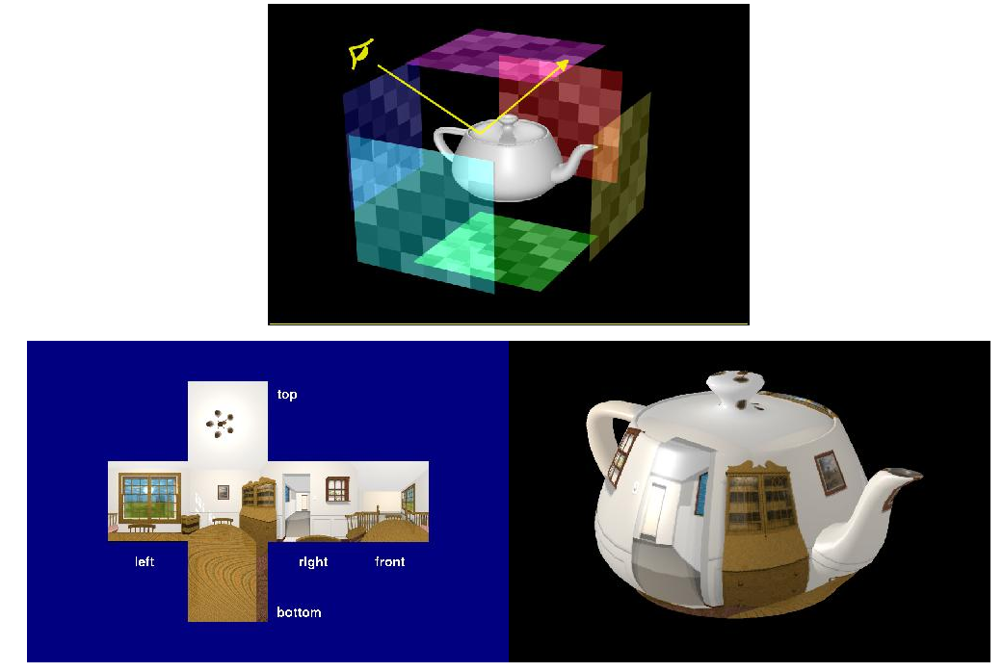
Environment Mapping
Mimic the environment by a cube
Notes:
http://www.youtube.com/watch?v=XJojMJbarvI
http://www.youtube.com/watch?v=Oem865j2u0A
http://www.youtube.com/watch?v=JjsHQYitVNg&NR=1
http://www.youtube.com/watch?v=-zna06sckS0
http://www.youtube.com/watch?v=XVPosY72sRI&NR=1

Slide 38
Summary
Ray intersections
Understanding of the idea and implementation strategies for:
Ray tracing acceleration
  Hierarchical bounding volumes
  Spatial subdivision
Antialiasing
  Supersampling
  Adaptive sampling
CSG
Distributed ray tracing
  Antialiasing, Glossy reflection, Translucency, Soft shadows, Depth-of-field (out of focus), Motion blur

